Slide 1
Infosys Spring Board Virtual Internship Batch 11 Group 1 - ElectViz Election data Visualization for Media
Under the supervision of :
Mentor: Mrs.Nithyasri S J
By KRITIKA BALPANDE

Slide 2
INTRODUCTION
India has the world’s largest democracy, where elections are conducted across many states with thousands of candidates and millions of voters. Because of this scale, it is important to analyze election data from multiple perspectives.
Electviz is data visualization project developed using power BI .
Electviz transform large scale election data into interactive and informative dashboard that present clear analysis and insights from raw election data in an engaging manner , thereby improving clarity, transparency, and understanding.

Slide 3
OBJECTIVES
To analyze election data across years, states, and constituencies.
To study party performance, vote share, and seat dominance.
To understand voter turnout and gender representation.
To analyze electoral competitiveness using victory margin and winner strength.
To present insights through interactive and user-friendly dashboards.

Slide 4
MILESTONE
Milestone 1
Milestone 2
Milestone 3
Milestone 4
Data collected and preprocessed
The dataset collected from Kaggle ‘Indian Election Dataset’.
Data Preprocessing Steps:
Checking the data types of each column.
Checking for null /empty values
Checking for duplicates
Replaced mismatching or different spelling values in ‘state name’ and ‘party name’ column like Chhattisgarh and Chattisgarh .
Added a custom column ‘voters' turnout_%’ to calculate percentage of votes received over electors.
Dashboard creation started
The three-dashboard created in milestone 2.
Election overview page
Party performance analysis
Distribution of parliamentary constituency
Insight Generated:
Votes received increases over year . So , an increasing trend indicates rising voter participation.
Densely Populated area stands out in contribution of significantly more votes.
Gender imbalance remains significant, as male candidates dominate across all constituency types, while female participation is increasing slowly..
After analyzing party performance and distribution of parliamentary constituency . The two more-dashboard added .
Year wise analysis
State level analysis
Insight Generated
There is male dominance in winning candidates compare to female winning candidates.
It shows that increases in total votes do not consistently align with higher turnout percentages, indicating no clear positive relationship between voter participation and total votes.
Vast majority of the total votes received concentrated towards two or three major parties .
After year wise and state level analysis , the three-dashboard added to understand gender representation , party performance and competitive nature of election.
Gender wise analysis
Candidate performance analysis
Electoral competitiveness and winner analysis.
Insight Generated
Male dominant in election both in numbers and total votes received.
Some parties win more seats even with small vote shares, and some parties win low seats with high votes share showing high seats does not mean high votes received.
.

Slide 5
SYSTEM OVERVIEW AND WORKFLOW DESIGN
Indian election takes place across many states with million of voters and thousand of candidates. However large election data is complex and difficult to interpret . There is need visual approach to understand patterns of the dataset
Problem Identification
The dataset used for this project was sourced from Kaggle, titled “Indian Election Dataset” by Nanadan Pandey.
This dataset contains detailed candidate-level election data for the Lok Sabha elections.
Before creating dashboard, raw data is converted into analysis ready format by handling null values , identifying duplicate columns , correcting data types of features and custom column creation
Dashboard and DAX measure creation
Problem Identification
Data Modelling
Data Collection and preprocessing
Documentation and Presentation
Data Collection
Data Preprocessing
Grouped the data by constituency and year to find maximum votes. Then merged that table with main table to create custom winner column using conditional logic.
Created a simple and elegant dashboard using different visuals to understand election data from multiple perspectives.
Created DAX measures like victory margin %, winner strength %
After building the dashboard and analyzing insights, we documented the complete project including methodology, calculations, and findings, and prepared a structured presentation for demonstration.
Data Modelling
Dashboard Creation
Documentation and presentation

Slide 6
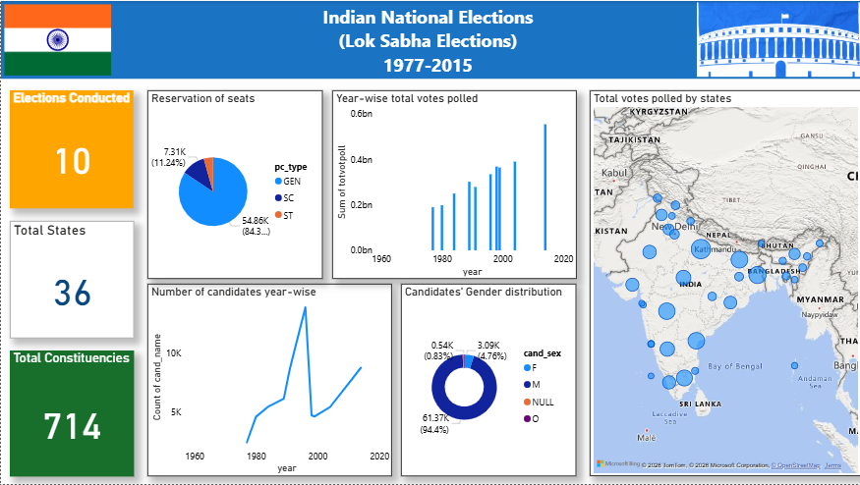
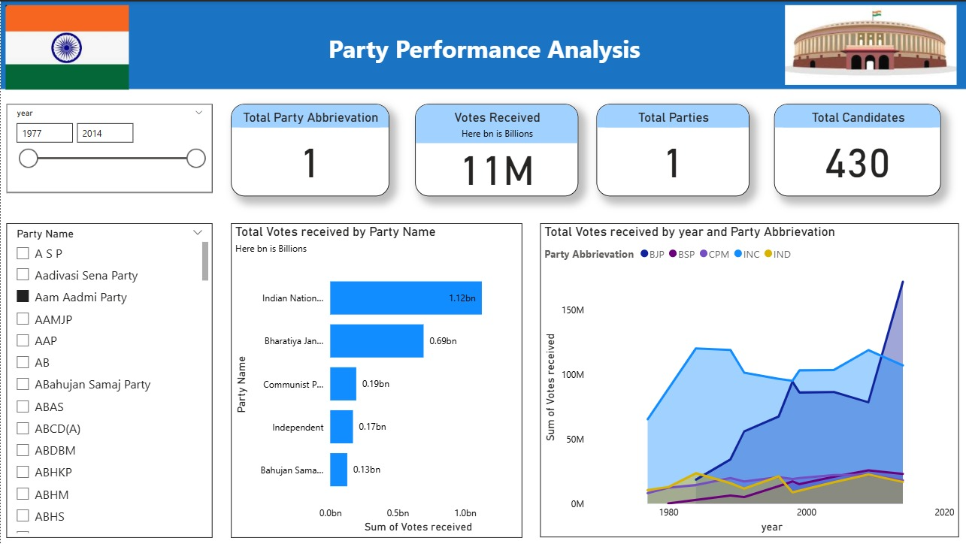
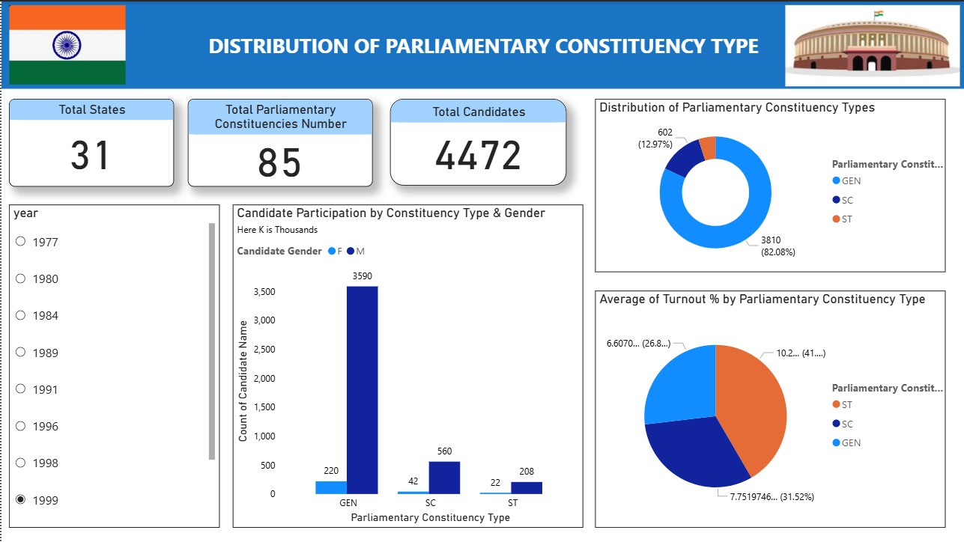
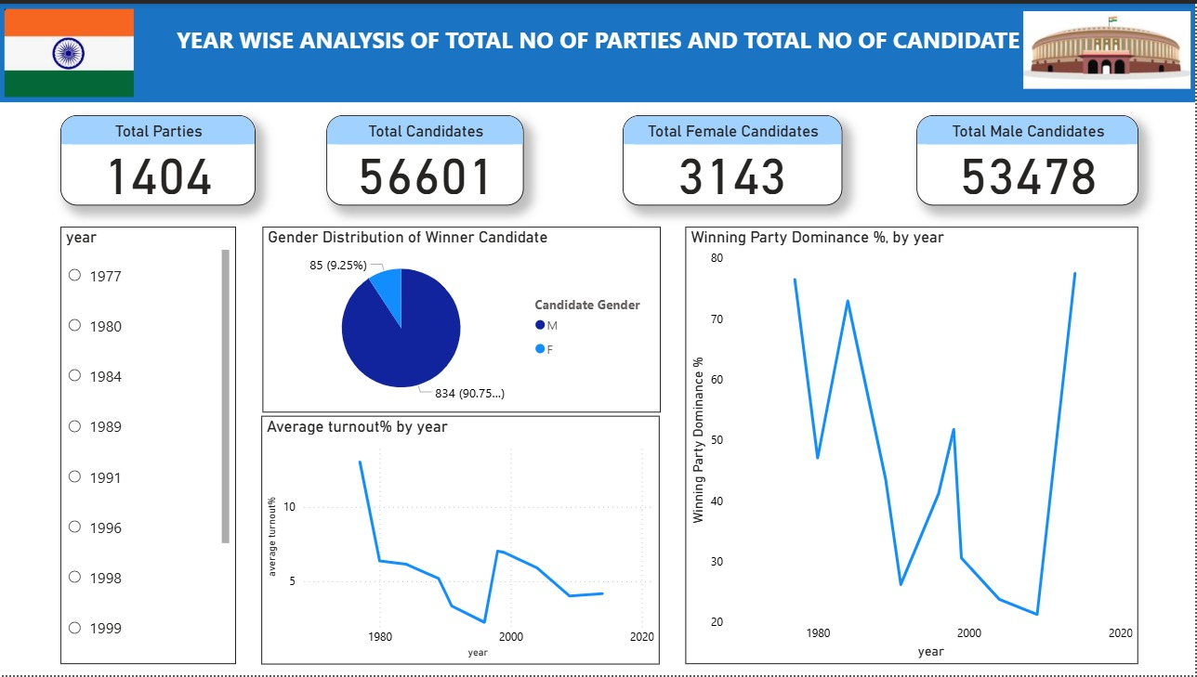
DASHBOARD

Slide 7
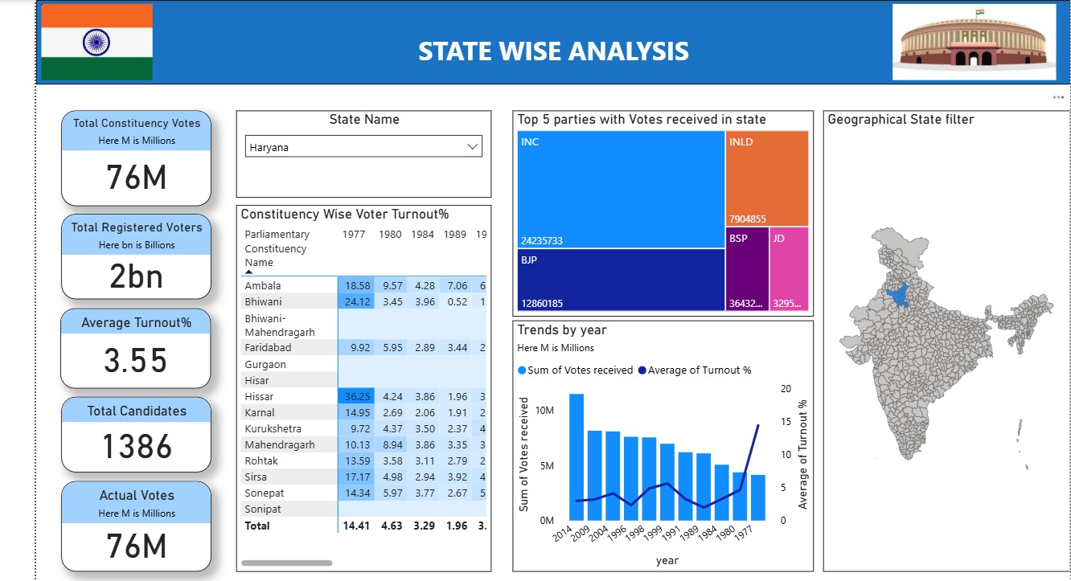
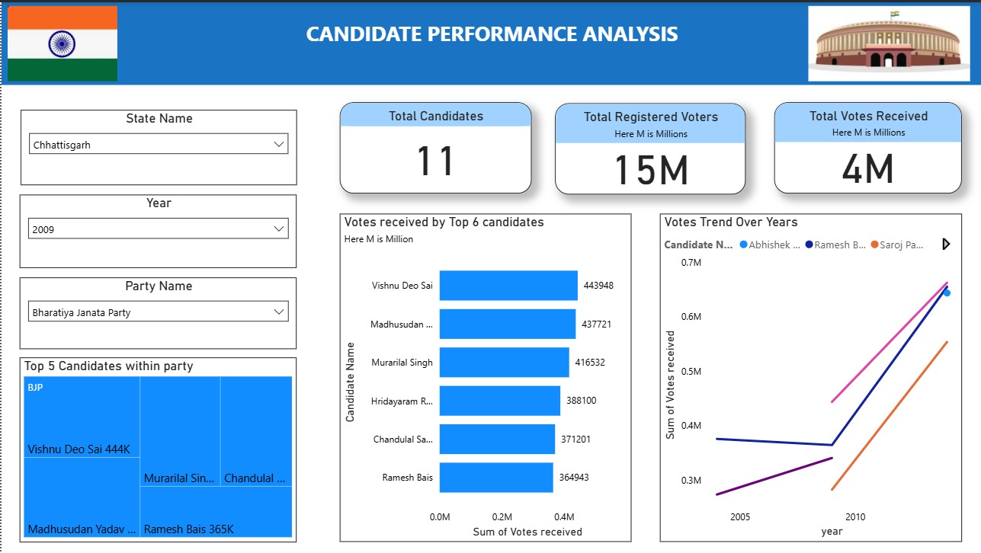
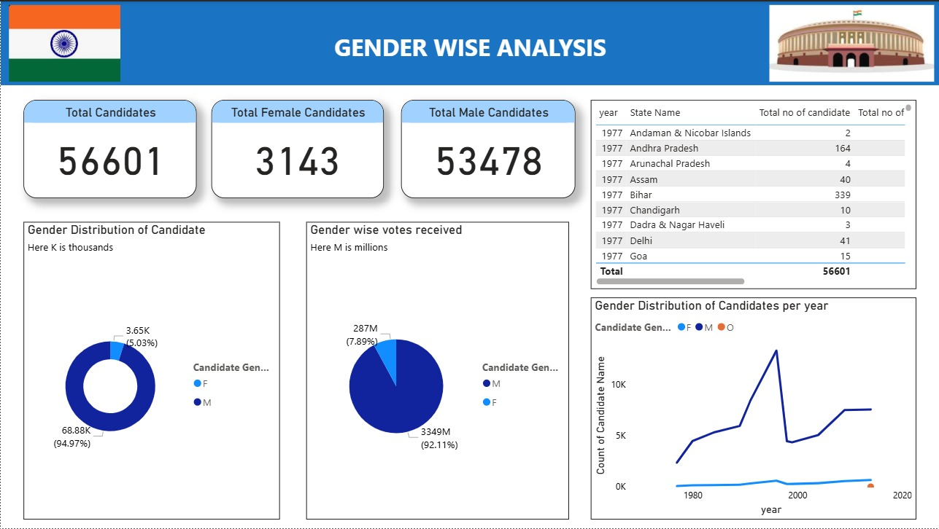
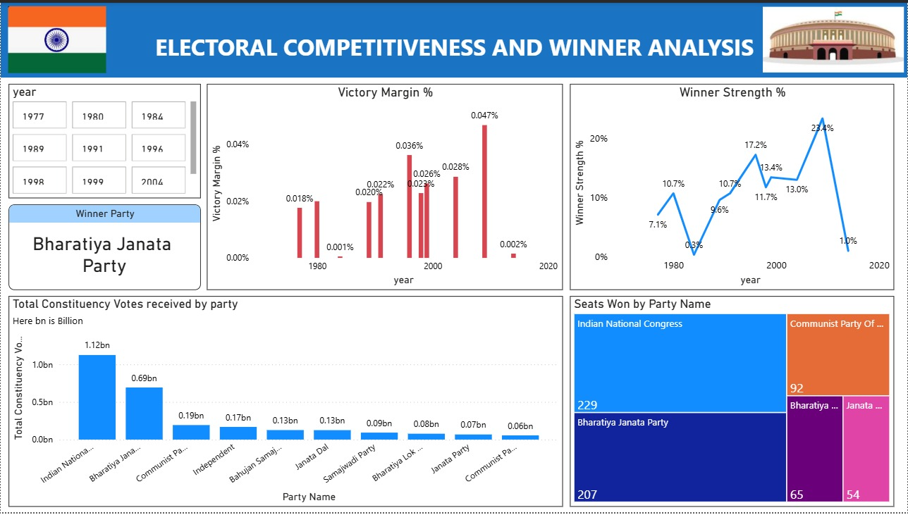

Slide 8
KEY INSIGHTS
There is gender imbalance in Indian election i.e. male dominance although Female participation increases over time but still low .
Majority of parliamentary constituency belongs to General , followed by ST and SC but ST and SC place important role in voter participation by showing higher voter turnout%.
Winner Strength % and Victory margin % across year are fluctuating which tells that in some year elections are highly dominating or in some year election are less dominating.
Some parties win more seats even with small vote shares, and some parties win low seats with high votes share showing high seats does not mean high votes received.
Some parties win more seats even with small vote shares, and some parties win low seats with high votes share showing high seats does not mean high votes received.

Slide 9
FUTURE ENHANCEMENT
Addition of recent election data and to see changes in past and present data.
Applying predictive algorithm to Predict future election outcomes.
Applying unsupervised technique to find out state or parliamentary constituency with low turnout% and female representation. This helps the authority to increase awareness in particular area .
AI driven anomaly detection automatic flag unusual spikes or drops in voting patterns that deviate from historical trends.
ML can identify specific regions with unusual low turnout% , enabling targets strategies and actions designed to ensure that all eligible citizens can participate fully .

Slide 10
CONCLUSION
This project analyzed Indian national-level election data to understand voting patterns, candidate performance, party dominance, gender participation, and electoral competitiveness across multiple years and states. Since Indian elections involve thousands of candidates and millions of voters, analyzing such data helps convert a complex democratic process into meaningful insights.
Through effective data preprocessing, calculated measures, and interactive dashboards, raw election data was transformed into clear and actionable visual stories. The dashboards highlight how votes translate into seats under the First-Past-The-Post system, how competitive elections are across years, how victory margins differ, and how candidate and gender representation has evolved over time.
The project also demonstrates the importance of choosing correct metrics and visuals to avoid misleading interpretations, especially when dealing with large-scale public data. By using slicers and filters, users can explore insights at state, party, year, and candidate levels, making the analysis flexible and user-friendly.
Overall, this project shows how data analytics and visualization tools like Power BI can support transparency, better understanding of electoral outcomes, and informed discussions about democracy. It successfully bridges the gap between raw election data and meaningful insights, making complex election trends easy to understand for both technical and non-technical audiences.

Slide 11
ACKNOWLEDGMENT
We would like to express our heartfelt gratitude to :
Infosys Springboard Team - for organizing this valuable internship opportunity.
Our Mentor - for her continuous support and feedback.
My Teammates - for collaboration, encouragement, and insights
This internship has been a significant step in our professional growth and technical journey.
REFERENCES
Election Dataset(Indian Election Dataset/ Kaggle source) “Indian Election Dataset” by Nanadan Pandey.
Microsoft Power BI Documentation.
Infosys Springboard Virtual Internship course materials.

Slide 12
Thank You..

